Slide 1


Building and Deploying Models in Julia
Chase DeHan, PhD
Data Scientist
Progressive Leasing
Boston | May 4, 2018
github.com/chasedehan/odsc_east_2018

Slide 2
Why this Talk?
Vendors selling deployment solutions
From a code perspective, not that difficult to do
Julia is a cool language

Slide 3
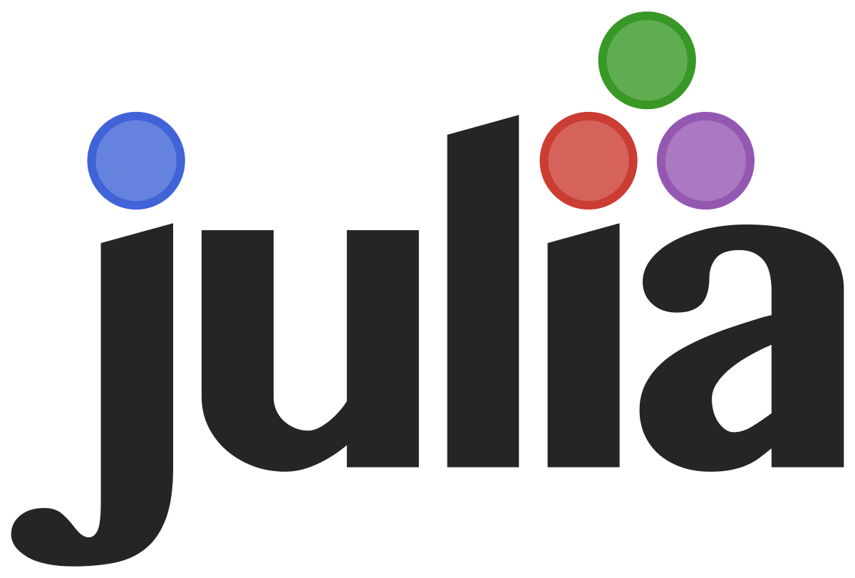
Why Julia?
“Walk like Python, Run like C”
Performance gains and relatively easy transition from Python/R
Access to and integration with Python/C/R libraries
Can use loops rather than cryptic numpy
Optimized for machine learning
Julia 1.0 in a few months?

Slide 4
Why a RESTful API for model deployment?
Stateless
Uniform interface (POST, GET)
POST supplies additional data (i.e. JSON, XML)
GET has everything in the URL
De-coupled
Can be a different language

Slide 5
Model Build in Python
Just for comparisons sake and to demonstrate how you might do this in Python/Flask
python_model_build.py

Slide 6
Basic Julia Example
julia_example.jl

Slide 7
Now, implement a Julia API
julia_web_server.jl

Slide 8
